Slide 1

Web Applications with Flask
Course Introduction
SoftUni Team
Technical Trainers
Software University
https://softuni.bg/

Slide 2
Table of Contents
Course Objectives
Exam
Training Team
Course Organization
Course Infrastructure
Evaluation Criteria
2

Slide 3
Have a Question?
sli.do
#Flask

Slide 4












SoftUni Diamond Partners

Slide 5


Educational Partners

Slide 6

Course Objectives

Slide 7
Web Apps with Flask Objectives
Flask and FlaskRESTful
Working with PostgreSQL, SQLAlchemy, Alembic
Marshmallow Schemas
JWT Authentication and Authorization
Unit Testing
3rd Parties (AWS S3 Buckets)
Clean Architecture and Structuring
7

Slide 8

Exam

Slide 9
Practical Exam - Project Defence
Project
Presentation – 15 min. each student
5 minutes project demo
10 minutes questions from the examiner related to the project and course material
9

Slide 10
Theoretical Exam
Available during the project defense time scope
Multiple-choice with 1 or more correct answers
English
Automated quiz system
You can submit your answers just one time
You can navigate through the questions

Slide 11

The Team

Slide 12
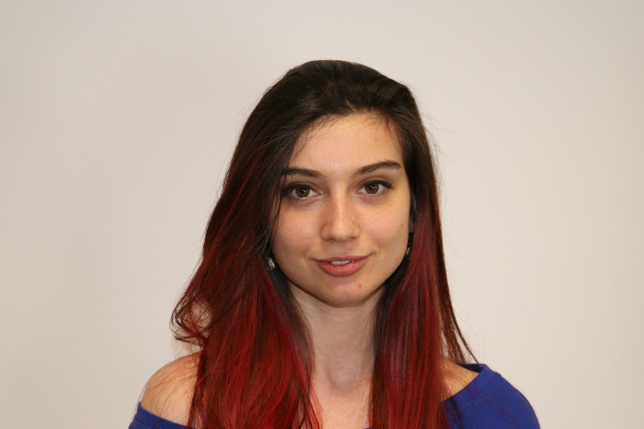
Ines Ivanova Kenova
Senior Python Software Engineer at Nmible
Full Stack Freelance Developer
Python, Django, Flask, FastAPI
Docker
Angular 2+
DevOps Enthusiast

Slide 13

Course Organization

Slide 14
Course Timeline
6-Jun-2022
28-Aug-2022
4-Sep-2022
Web Applications with Flask
8 weeks * 1 times / week
9 credits
Start: 6-Jun-2022
Exam: 28-Aug-2022
Exam Retake: 4-Sep-2022

Slide 15


SoftUni Certificate
Practical Exam 100%
Evaluation
15

Slide 16
CPE Certificate
Practical Exam 100%
Theoretical Exam 100%
Evaluation
16

Slide 17



Course Web Site, Forum and FB Group
Official web site:
Official discussion forum:
Official Facebook group:
https://softuni.bg/trainings/3815/web-applications-with-flask-june-2022
https://softuni.bg/forum/categories/825/flask-web-applications
https://www.facebook.com/groups/WebApplicationswithFlaskJune2022

Slide 18
Questions?
Notes:
18

Slide 19
Trainings @ Software University (SoftUni)
Software University – High-Quality Education, Profession and Job for Software Developers
softuni.bg, softuni.org
Software University Foundation
softuni.foundation
Software University @ Facebook
facebook.com/SoftwareUniversity
Software University Forums
forum.softuni.bg
19
Notes:
19

Slide 20

License
This course (slides, examples, demos, exercises, homework, documents, videos and other assets) is copyrighted content
Unauthorized copy, reproduction or use is illegal
© SoftUni – https://softuni.org
© Software University – https://softuni.bg
Notes:
20

